Slide 1


Research Project two
Local Root Serving by Default:
Quantifying the Traffic Trade-off BetweenRoot Queries and Root Zone Distribution
Ilyas Rahimi
12330337
Supervisor: Dr. Marios Avgeris
CoSupervisor: Willem Toorop
Security and Network Engineering
University of Amsterdam

Slide 2
Introduction
DNS Root: The starting point of name resolution.
Current Model: Resolvers depend on the 13 public root server identities.
Operational Conditions: The root zone is small, but the infrastructure handles traffic at a massive scale.
Cornerstone: DNS robustness depends on root availability.

Slide 3
Local Root Serving
Definition: Resolvers maintain a local copy of the root zone.
Function: Answer root-level queries locally rather than forwarding them.
Proposed BCP: IETF DNSOP working group proposal.
Motivations: Reduced reliance on external infra, improved behavior during outages, and enhanced privacy.
https://datatracker.ietf.org/doc/draft-wkumari-dnsop-localroot-bcp/

Slide 4
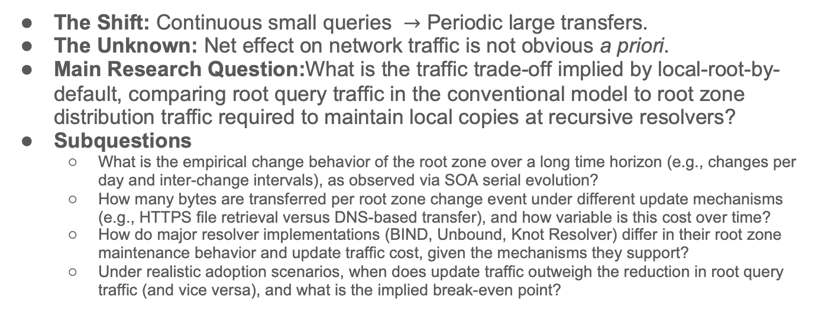
The Problem & Research Question
The Shift: Continuous small queries $→$ Periodic large transfers.
The Unknown: Net effect on network traffic is not obvious a priori.
Main Research Question:What is the traffic trade-off implied by local-root-by-default, comparing root query traffic in the conventional model to root zone distribution traffic required to maintain local copies at recursive resolvers?
Subquestions
  What is the empirical change behavior of the root zone over a long time horizon (e.g., changes per day and inter-change intervals), as observed via SOA serial evolution?
  How many bytes are transferred per root zone change event under different update mechanisms (e.g., HTTPS file retrieval versus DNS-based transfer), and how variable is this cost over time?
  How do major resolver implementations (BIND, Unbound, Knot Resolver) differ in their root zone maintenance behavior and update traffic cost, given the mechanisms they support?
  Under realistic adoption scenarios, when does update traffic outweigh the reduction in root query traffic (and vice versa), and what is the implied break-even point?

Slide 5
Methodology
Two Perspectives:
  Root-side: RSSAC002 aggregate statistics.
  Resolver-side: Direct measurement in a controlled testbed.
Unit of Measure: Bytes per resolver per day.
Approach: Derived baseline vs. measured reality.

Slide 6
Methodology – RSSAC002 & Baseline
RSSAC002: Standard reporting framework for Root Servers.
Metric 1: Total query/response counts.
Metric 2: Packet size distributions (bucketed).
Metric 3: Unique source IP counts.
Calculation: (Total Bytes) / (Unique Source IPs) = Baseline traffic per resolver.
https://itp.cdn.icann.org/en/files/root-server-system-advisory-committee-rssac-publications/rssac-002-measurements-root-22jun23-en.pdf.

Slide 7
Experimental Setup
Environment: Proxmox virtualization platform.
Isolation: Components communicated over a local virtual network.
Software: Recent Linux distribution; open-source resolver software.
Observation: 4 consecutive days of production root zone evolution.

Slide 8
Resolver Roles & Update Mechanisms
BIND: DNS-based IXFR (Incremental transfers).
Unbound (Role A): DNS-based IXFR.
Unbound (Role B): HTTPS-based retrieval.
Knot Resolver: Native HTTPS-based local root functionality.
Traffic Captured: DNS/HTTPS payloads + TCP/TLS/Control overhead.

Slide 9
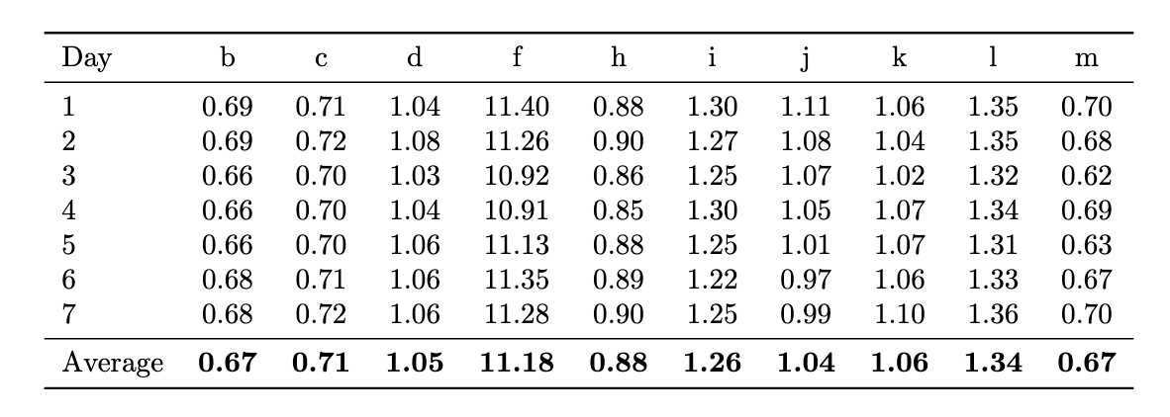
Results Conventional Traffic
Table 1 Summary:
  Most roots: 0.67 to 1.34 MB/day.
  F-root outlier: 11.18 MB/day.
System-wide Average: Approximately 2 MB/day.

Slide 10
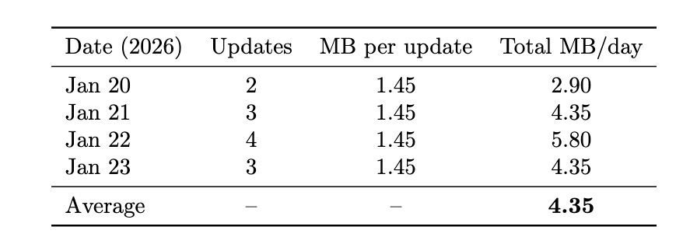
Results BIND (DNS-based IXFR)
Mechanism: Triggered by SOA serial changes.
Data Size: ~1.45 MB per incremental update.
Daily Average: 4.35 MB/day.
Pattern: Traffic scales with the number of updates (2–4 per day).

Slide 11
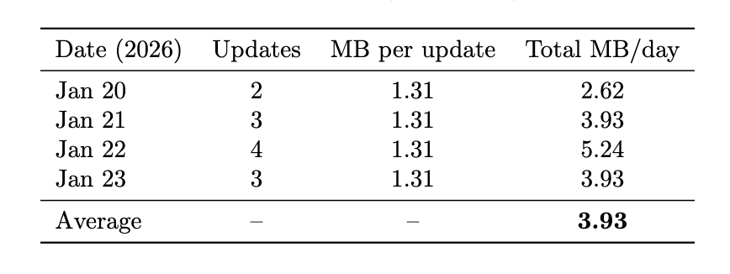
Results Unbound (DNS-based IXFR)
Mechanism: Identical update logic to BIND.
Data Size: ~1.31 MB per incremental update.
Daily Average: 3.93 MB/day.
Comparison: Slightly more efficient than BIND in per-update transfer size.

Slide 12
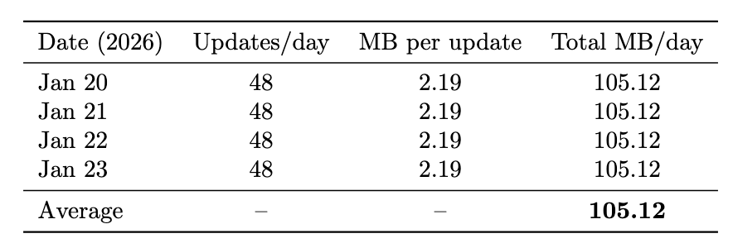
Results Unbound (HTTPS-based)
Mechanism: Polling full zone every 30 mins over HTTPS.
Data Size: 2.19 MB per update (Full Zone).
The Anomaly: 105.12 MB/day.
Analysis: 48 full downloads/day; considered a bug/limitation in current logic.

Slide 13
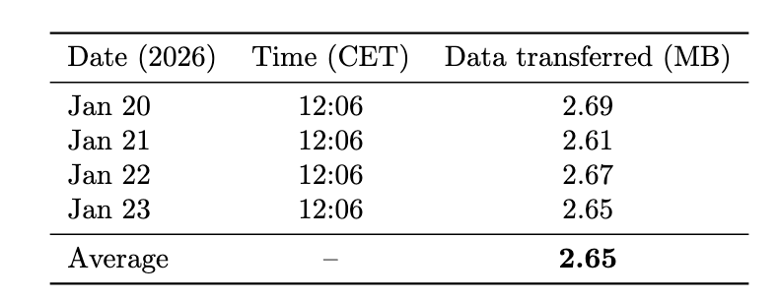
Results Knot Resolver (HTTPS-based)
Mechanism: Conservative update strategy.
Frequency: Approximately one full update per day.
Daily Average: 2.65 MB/day.
Finding: Most efficient local root configuration evaluated.

Slide 14
Results – Scaling Impact
Scenario: Global adoption levels (10%, 20%, 30%).
Population: ~59.1 million resolvers.
Metric: Additional daily traffic in Terabytes (TB).
Result (Knot 10%): +3.8 TB/day.
Result (Unbound HTTPS 10%): +27.0 TB/day.

Slide 15
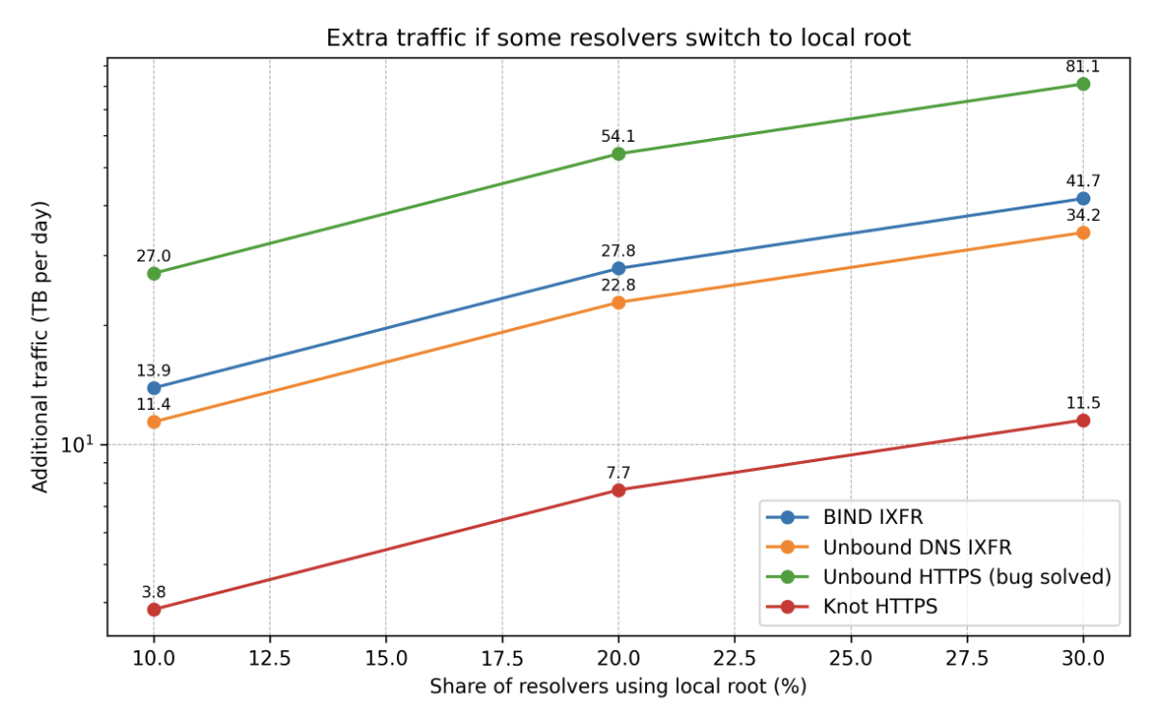
Results – Scaling Impact

Slide 16
Discussion Frequency vs. Protocol
Primary Driver: Update frequency is more important than protocol choice.
Knot vs. Unbound: Both used HTTPS, yet outcomes differed by ~100 MB.
Conclusion: Software logic and design philosophy (Conservative vs. Aggressive) determine the traffic cost.

Slide 17
Discussion Implementation Strategies
DNS IXFR: Stable and predictable; tied to root zone dynamics.
Knot (Conservative): Deliberately avoids frequent polling (RFC 7706 interpretation).
Unbound (Bug): Current HTTPS behavior is independent of actual root zone dynamics.

Slide 18

Discussion Comparison with Conventional
The Verdict: Local root operation consistently generates more traffic per resolver.
Shift in Pattern: Many small, lightweight queries $→$ Fewer, larger bulk transfers.
Outcome: Not an optimization, but a cost paid for resilience.

Slide 19
Conclusion
Summary: Quantified the traffic implications of local root serving.
Impact: Positive additional traffic across all configurations.
Trade-off: Higher bandwidth usage for improved resilience and privacy.
Guidance: Operators should prioritize change-aware update mechanisms.

Slide 20
Future Work Incremental Signing
Root Signing: Currently produced/signed as a single unit.
Inefficiency: Minor changes force full zone downloads for non-DNS mechanisms.
Opportunity: Incremental signing could allow distribution of smaller, verifiable parts.

Slide 21
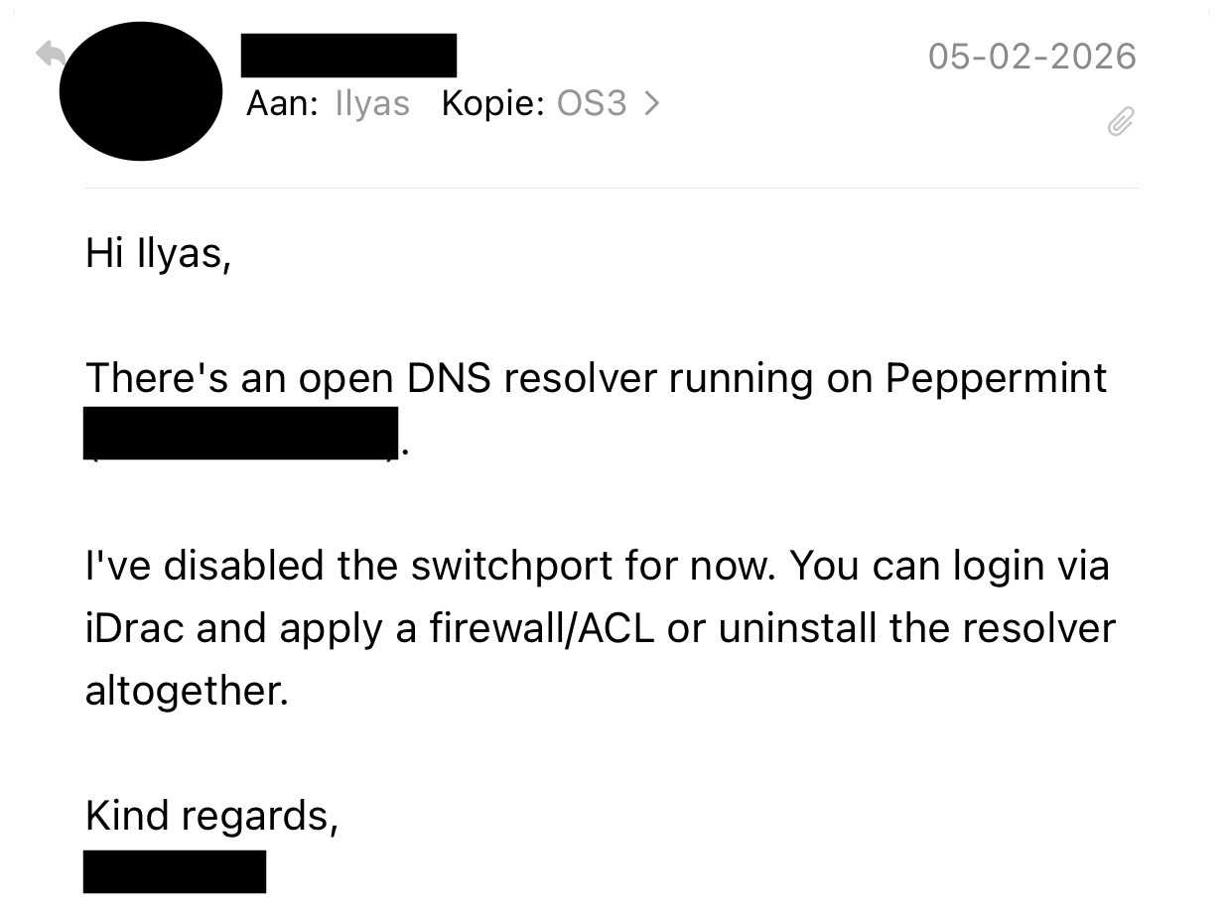
Lessons learned

Slide 22

Acknowledgements & Q&A
Acknowledgements: Supervisors dr. Marios Avgeris and Willem Toorop.
Final Statement: Thank you for your attention.

