Slide 1
OpenDNSSEC 2.0 and Beyond
Benno Overeinder
NLnet Labs

Slide 2
INTRO

Slide 3
About NLnet Labs
Not-for-profit R&D company
  open standards
  open source software
  innovation & expertise for benefit of open Internet
Mission & goal
  contribute to bridge gap between research and practical deployments
  https://www.nlnetlabs.nl/labs/mission/

Slide 4
About NLnet Labs cont’d
Open source software
  infrastructure: NSD, Unbound
  provisioning: OpenDNSSEC, …
  libraries: getdns API, ldns
Community activities
  standards: IETF (drafts and RFCs)
  research & operational insights: RIPE, DNS OARC, …
  policy and governance: ICANN, ...

Slide 5
OpenDNSSEC in Context

Slide 6
The World According to OpenDNSSEC
OpenDNSSEC
DNS(SEC)
deployment/
provisioning/operations
DNSSEC-aware
applications (e.g. DANE)

Slide 7
DNSSEC DNS Security Extensions
DNSSEC in one two slides

Slide 8
What is DNSSEC?
the one slide version
Digital signatures are added to responses by authoritative servers for a zone
Validating resolver can use signature to verify that response is not tampered with
Trust anchor is the key used to sign the DNS root
Signature validation creates a chain of overlapping signatures from trust anchor to signature of response
credits Geoff Huston
Notes:
Lot of information on one slide, just remember the last bullet point

Slide 9
DNSSEC and Validation
in a single picture
.
DS record .nl. + signature
4
A record www.nlnetlabs.nl.
+ signature
.nl.
1
DS record .nlnetlabs.nl. + signature
DNSKEY record .nl. + signature
3
validating resolver
.nlnetlabs.nl.
local root key (preloaded)
DNSKEY record .nlnetlabs.nl. + signature
5
2

Slide 10
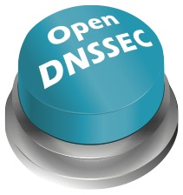
DNSSEC Deployment and Provisioning

Slide 11
What is OpenDNSSEC?
Turn-key solution for DNSSEC
  make DNSSEC easy to deploy
  name server agnostic
Automates
  zone signing and management
  key & rollover management
RFC compliant

Slide 12
Key Features
Bump in the wire
Policy-driven configuration
  signature refresh period
  key algorithm/length, rollover
Files or IXFR/AXFR
Support for Hardware Security Modules (HSM)
Several high-profile reference deployments
<Signatures>
<Resign>PT2H</Resign>
<Refresh>P3D</Refresh>
<!-- Parameters for KSK only -->
<KSK>
<Algorithm length=“2048”>8</Algorithm>
<Lifetime>P1Y</Lifetime>
<Repository>SoftHSM</Repository>
</KSK>

Slide 13
Architecture
https://wiki.opendnssec.org/display/DOCS

Slide 14
SoftHSM v2
SoftHSM is a software-only implementation of a security module using PKCS#11 API
  can be used to test the PKCS#11 interface without using a real HSM
Uses Botan or OpenSSL for crypto
Alternatives
  real HSM $50–$50k depending FIPS 140-2 Level
  CrypTech board

Slide 15
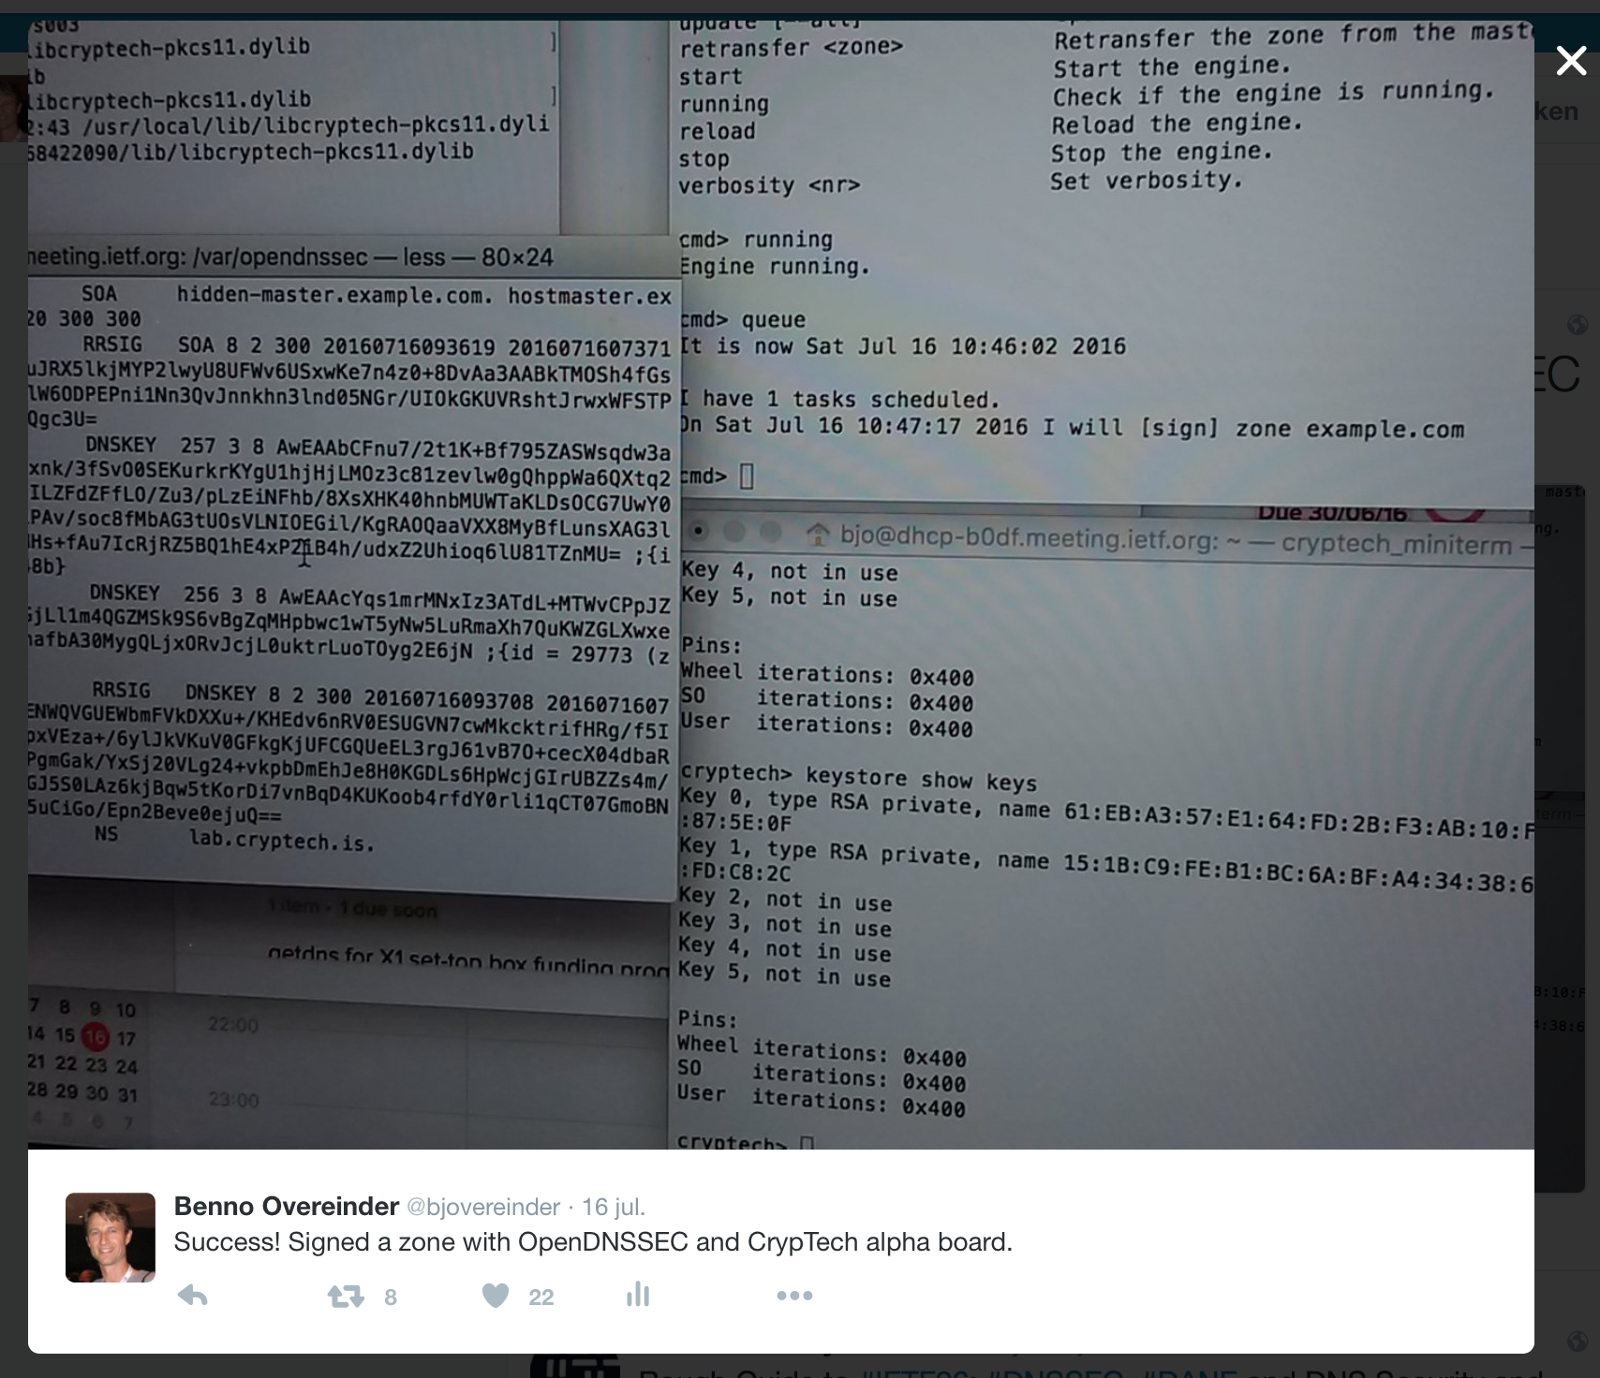
CrypTech (Alpha) Board
See for information https://cryptech.is
Notes:
More information on CrypTech projet from Leif Johansson and Linus Nordberg.

Slide 16
… and Next?

Slide 17
History of OpenDNSSEC
Releases
  OpenDNSSEC v1.0 (Feb 2012)
  current LTS 1.4
  latest release 2.0 (Jul 2016)
  planned release 2.1 (2016Q4)
  subsequent frequent 2.x releases
Project transferred to NLnet Labs in July 2014

Slide 18
OpenDNSSEC 1.4 → 2.0
OpenDNSSEC 1.4
  rigid
    key rollover continues although going bogus
    no emergency rollover
OpenDNSSEC 2.0
  redesign of Enforcer component
    no procedural rollover, but goal-driven towards desired state
    see paper “Flexible and Robust Key Rollover in DNSSEC”, Proceedings of SATIN, March 2012

Slide 19
OpenDNSSEC 2.0 Key Features
Redesign Enforcer component
  performance
  support for multiple key rollover mechanisms
  support for algorithm rollover
  support for CSK—combined signing key
  support for unsigned zones (real bump in the wire)

Slide 20
ZSK Prepublication Rollover

Slide 21
CSK Algorithm Rollover

Slide 22
OpenDNSSEC 2.1, 2.2 and 2.x
OpenDNSSEC 2.1
  “stabilisation” of user experience: command-line tools and some functionality
OpenDNSSEC 2.2, 2.3, …
  performance as a structural property
    analogy with (simple) UDP (→ fast)
  compartmentalization
    user defines how the software is run
    self-contained building blocks
    integrated part of your DNS system
Notes:
e.g., you decide if you run your system with Chef, Puppet, or Ansible, OpenDNSSEC has to

Slide 23
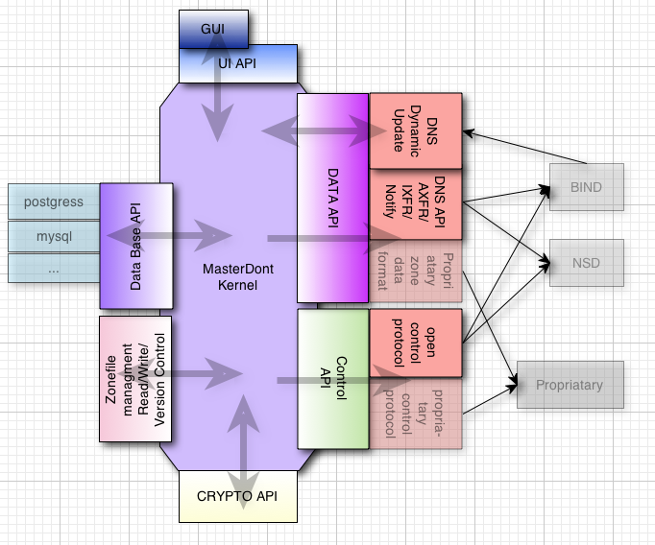
Masterdont Master Plan

Slide 24
DNSSEC-Aware Applications
Use-cases of DANE

Slide 25
Use-/Showcase Scenarios
✘
End-to-end authenticated and secured/encrypted communication
Secure customer interaction in web portal
Secure email
Instant messages/chat with OTR
…
Notes:
Secure email: authenticated TLS sessions between MTAs, email encryption with S/MIME and OpenPGP
Besides chat, also authenticated and encrypted SIP!

Slide 26
Customer–Web Portal Interaction
auth name servers
com.
acme.
portal.
full recursive resolver
customer
portal.acme.com
host
IP address
browser
web portal
http/https
http server
IP address

Slide 27
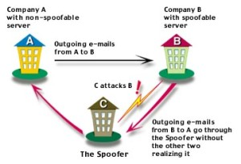
DNS Spoofing
DNS Spoofing by cache poisoning
  attacker flood a DNS resolver with phony information with bogus DNS results
  by the law of large numbers, these attacks get a match and plant a bogus result into the cache
Man-in-the-middle attacks
  redirect to wrong Internet sites
  email to non-authorized email server
Notes:
What risks?
Misdirection of queries for an entire domain
Response to non-existent domains
MX hijacking
Make a large domain (SLD or TLD) domain “disappear” from an ISP's cache – DoS
Identity theft using SSL stripping attacks (banks, eGovernance)
More fun stuff…
A great illustrated guide
http://unixwiz.net/techtips/iguide-kaminsky-dns-vuln.html

Slide 28
PKIX/X.509 Certificate Tree
Certification authorities (CAs)
  sign child certificates
  should verify child identity
  can be trust anchors (TAs)
TLS clients
  trust their trust anchors
All is good? CAs are trustworthy?
credits wes.hardaker@parsons.com
Notes:
Should verify the child's identity
- Domain ownership
- Or their legal business name

Slide 29
The “Too Many CAs” Problem
TLS clients have abundance of TAs
  modern web browsers have 1300+ TAs
  any of them can issue certificate for example.com
TLS client accepts both!
credits wes.hardaker@parsons.com
Notes:
Most notable incidents are with Comodo RA (2011) and DigiNotar (2011).

Slide 30
Customer–Web Portal Interaction Revisited
auth name servers
com.
acme.
portal.
full recursive resolver
DNS spoofing
customer
portal.acme.com
host
IP address
browser
web portal
too many CAs
http/https
http server
CA pinning/HSTS?
IP address
Notes:
vulnerabilities: - dns spoofiing, redirect, CAs only about names, CA pinning, HSTS (HTTP Strict Transport Security)

Slide 31
DANE: DNS-based Authentication of Named Entities
Securely specify which certificate an application or service should use
  works perfectly fine with existing CA certificates
DANE defines TLSA resource record and usage field
  0 – CA specification
  1 – specific TLS certificate
  2 – trust anchor assertion
  3 – domain issued certificate
Notes:
DNSSEC should allow clients to securely ask the operator of a domain about which certificates they should accept as credentials for that domain. The domain operator might specify constraints on certificate validation or even supply a new trust anchor.
0 – CA specification – The TLSA record specifies the Certificate Authority (CA) who will provide TLS certificates for the domain. Essentially, you are able to say that your domain will ONLY use TLS certificates from a specific CA. If the browser or other application using DANE validation sees a TLS cert from another CA the app should reject that TLS cert as bogus.
1 – Specific TLS certificate – The TLSA record specifies the exact TLS certificate that should be used for the domain. Note that this TLS certificate must be one that is issued by a valid CA.
2 – Trust anchor assertion – The TLSA record specifies the “trust anchor” to be used for validating the TLS certificates for the domain. For example, if a company operated its own CA that was not in the list of CAs typically installed in client applications this usage of DANE could supply the certificate (or fingerprint) for their CA.
3 – Domain-issued certificate – The TLS record specifies the exact TLS certificate that should be used for the domain, BUT, in contrast to usage #1, the TLS certificate does not need to be signed by a valid CA. This allows for the use of self-signed certificates.

Slide 32
DNSSEC, DANE and X.509
credits wes.hardaker@parsons.com
Notes:
To guard against the DigiNotar attack, Google could have provisioned a TLSA record expressing a CA constraint with their real CA (which is not DigiNotar) or a certificate constraint with their actual certificate

Slide 33
DNS-based Secure Customer–Web Portal Interaction
auth name servers
DNSSEC
com.
acme.
portal.
full recursive resolver
DNS spoofing
customer
portal.acme.com
host
IP address
browser
web portal
DANE
http/https
http server
too many CAs
IP address
Notes:
vulnerabilities: - DNSSEC to counter dns spoofiing, redirect; DANE complments CAs only about names, and alternative to CA pinning, HSTS

Slide 34
Concluding

Slide 35
Summary
OpenDNSSEC evolves to flexible solution
  user defines how it is run
  performance as a structural property
OpenDNSSEC training
  1 day course to 3 day “master class”
  training courses can be arranged based on demand
    recently DNSSEC/OpenDNSSEC training at LACNIC26

